Slide 1
Tree

Slide 2
Traversing a Binary Tree
Traversing a binary tree is the process of visiting each node in the tree exactly once in a systematic way.
Unlike linear data structures in which the elements are traversed sequentially, tree is a non linear data structure in which the elements can be traversed in many different ways.
There are different algorithms for tree traversals. These algorithms differ in the order in which the nodes are visited.

Slide 3

Pre-order Traversal
To traverse a non-empty binary tree in pre-order, the following operations are performed recursively at each node. The algorithm works by:
1. Visiting the root node,
2. Traversing the left sub-tree, and finally
3. Traversing the right sub-tree.
The pre-order traversal of the tree is given as A, B, C.

Slide 4
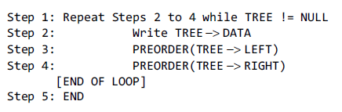
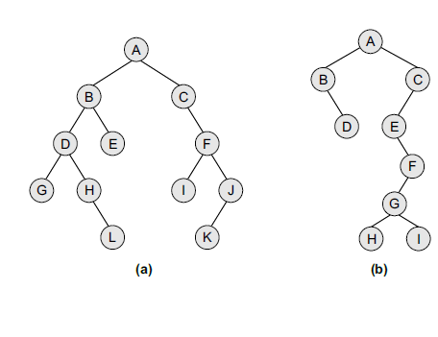

Algorithm for Pre-Order

Slide 5
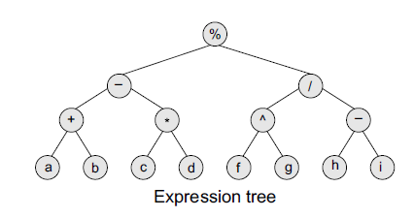
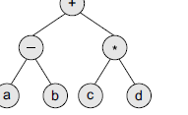
Pre-order traversal algorithms are used to extract a prefix notation from an expression tree.
For example, consider the expressions given below. When we traverse the elements of a tree using the pre-order traversal algorithm, the expression that we get is a prefix expression.
+ – a b * c d
% – + a b * c d / ^ e f – g h

Slide 6
In-order Traversal
To traverse a non-empty binary tree in in-order, the following operations are performed recursively at each node. The algorithm works by:
1. Traversing the left sub-tree,
2. Visiting the root node, and finally
3. Traversing the right sub-tree.

Slide 7
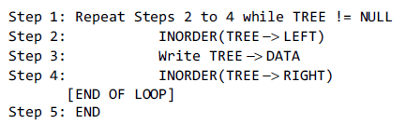
Algorithm for In-Order

Slide 8
Post-Order Traversal
To traverse a non-empty binary tree in post-order, the following operations are performed recursively at each node. The algorithm works by:
1. Traversing the left sub-tree,
2. Traversing the right sub-tree, and finally
3. Visiting the root node.

Slide 9
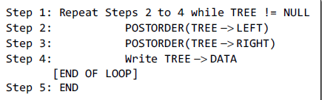
Algorithm for Post-Order

Slide 10
Binary Search Tree
A binary search tree, also known as an ordered binary tree, is a variant of binary trees in which the nodes are arranged in an order.
In a binary search tree, all the nodes in the left sub-tree have a value less than that of the root node.
Correspondingly, all the nodes in the right sub-tree have a value either equal to or greater than the root node.
The same rule is applicable to every sub-tree in the tree. (Note that a binary search tree may or may not contain duplicate values, depending on its implementation.)

Slide 11
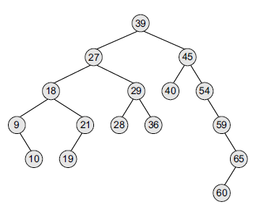
Insert 39,27,45,18,29,40,9,21,10,19,54,59,65,60 in binary search tree
The root node is 39. The left sub-tree
of the root node consists of nodes 9, 10, 18, 19, 21, 27, 28, 29, and 36. All these nodes have smaller values than the root node.
The right sub-tree of the root node consists of nodes 40, 45, 54, 59, 60, and 65. Recursively, each of the sub-trees also obeys the binary search tree constraint.
For example, in the left sub-tree of the root node, 27 is the root and all
elements in its left sub-tree (9, 10, 18, 19, 21) are smaller than 27, while all nodes in its right sub-tree (28, 29, and 36) are greater than the root node’s value.

Slide 12
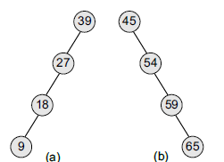
Insertion and Deletion in Binary Search Tree
Binary search trees speed up the insertion and deletion operations. The tree has a speed Advantage when the data in the structure changes rapidly.
Binary search trees are considered to be efficient data structures especially when compared with sorted linear arrays and linked lists.
In a sorted array, searching can be done in O(log₂ n) time, but insertions and deletions are quite expensive.
In contrast, inserting and deleting elements in a linked list is easier, but searching for an element is done in O(n) time.
However, in the worst case, a binary search tree will take O(n) time to search for an element. The worst case would occur when the tree is a linear chain of nodes as given in Figure.

Slide 13
To summarize, a binary search tree is a binary tree with the following properties:
The left sub-tree of a node N contains values that are less than N’s value.
The right sub-tree of a node N contains values that are greater than N’s value.
Both the left and the right binary trees also satisfy these properties and, thus, are binary search trees.

Slide 14
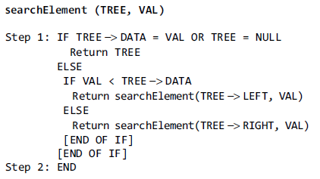
Searching for a node in Binary Search Tree

Slide 15
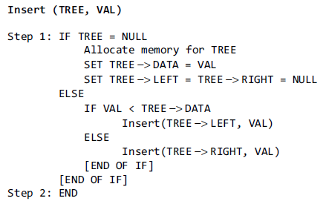
Insertion into Binary Search Tree

Slide 16
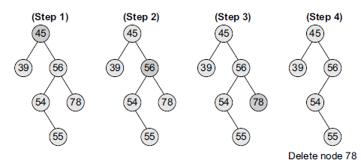
Deletion from Binary Search Tree
Case 1: Deleting a Node that has No Children
binary search tree given in Figure
If we have to delete node 78, we can simply remove this node without any issue. This is the simplest case of deletion.

Slide 17
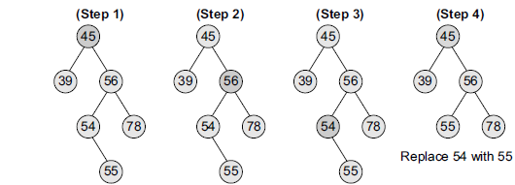
Case 2: Deleting a Node with One Child
the node’s child is set as the child of the node’s parent.
In other words, replace the node with its child.
Now, if the node is the left child of its parent, the node’s child becomes the left child of the node’s parent.
Correspondingly, if the node is the right child of its parent, the node’s child becomes the right child of the node’s parent.
shown in Figure that how deletion of node 54 is handled.

Slide 18
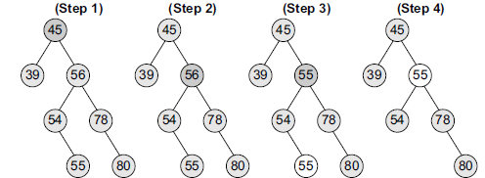
Case 3: Deleting a Node with Two Children
Replace the node’s value with its in-order predecessor (largest value in the left sub-tree) or in-order successor (smallest value in the right sub-tree).
The in-order predecessor can then be deleted using any of the above cases. Look at the binary search tree given in Figure and see how deletion of node with value 56 is handled.

Slide 19
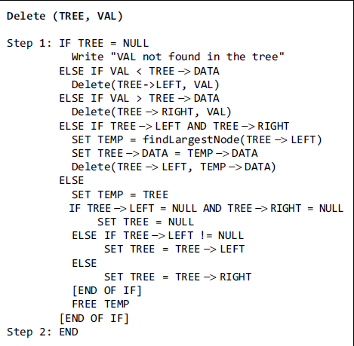
Algorithm for Deletion

